Slide 1
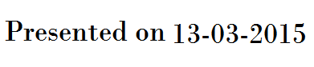
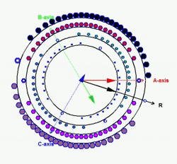
Embedded solutions for control of Drives using space vector modulation technique
By
M. Senthil Kumaran
“Design is a funny word. Some people think design means how it looks. But of course, if you dig deeper, it's really how it works.”
- Steve Jobs
SSNCE /EEE/ 13-03-2015/S1

Slide 2

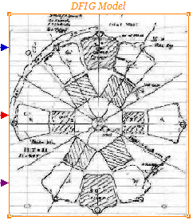
About the Lecture
தாமின் புறுவது உலகின் புறக்கண்டு
காமுறுவர் கற்றறிந் தார்.
தாமின் புறுவது உலகின் புறக்கண்டு
மாடல மற்றை யவை
தாமின் புறுவது உலகின் புறக்கண்டு
மாடல மற்றை யவை
SSNCE /EEE/ 13-03-2015/ S2

Slide 3
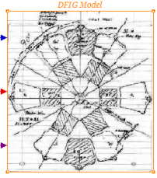
About the Lecture
It is in the Desire to share and not to teach…….
Senthil Kumaran Mahadevan
So nothing here is right or wrong every thing is wonderful
Have a nice Day…….
SSNCE /EEE/ 13-03-2015/ S3

Slide 4
Thanks …………..
To my Students
J. B. Mervin (M.E- II)
S. Adithiya (B.E- III)
Senthil Kumaran Mahadevan
For encouraging me
&
For making this happen
SSNCE /EEE/ 13-03-2015/ S4

Slide 5
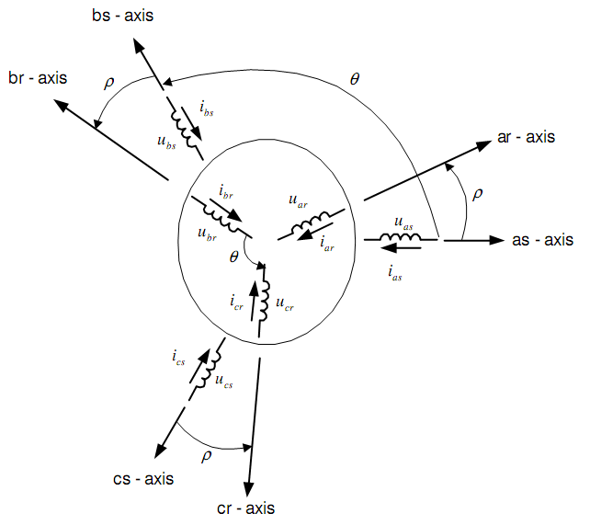
Space Vector insight from a Machines
Production of Space Vector in Machines
When spatially distributed windings are supplied with time displaced currents
The Resultant Flux in the space [ Air gap] - Rotates
The speed of rotation is given by
120* f / P
Two – Field Revolving Theory

Slide 6
Three Stationary Windings Becomes a Single Rotating Winding
When windings are Excited by three phase Sinusoidal currents the combined effect is equivalent to single Sinusoidally distributed winding excited with a constant DC currents and Rotating at the excited frequency.
The speed of rotation is given by
120* f / P
Two – Field Revolving Theory

Slide 8
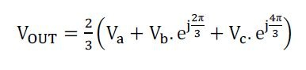
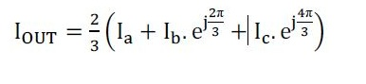
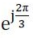
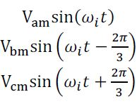
Mathematical Representation of - SV
Where represents the spatial displacement of the winding by 120 degree in the complex plane.
Represents the time displaced voltages in space displaced 3 phase windings.

Slide 9
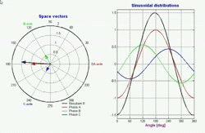
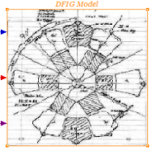
One who Sees Knows…….
One who Knows Shows……

Slide 10
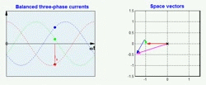

One who Sees Knows…….
One who Knows Shows……

Slide 11
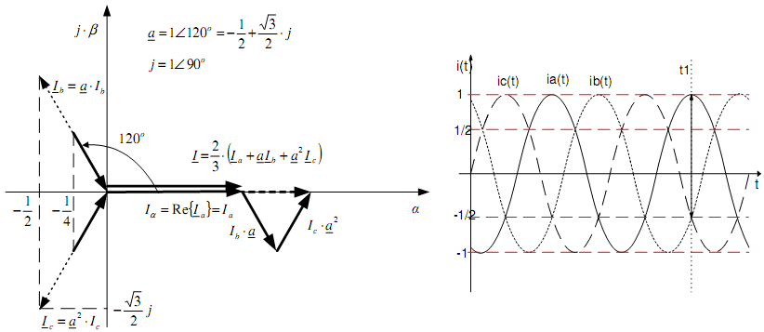
Graphical Representation of - SV
Space Vector formulation from a 3Phase System
I = [i_{a} – ½(i_{b}+i_{c})] +j[ [√3/2]*(i_{b}-i_{c})]
Mathematics is the only language of Engineer.

Slide 12
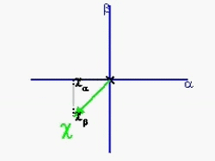
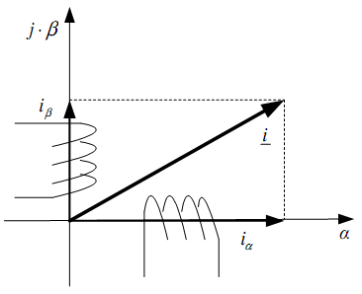
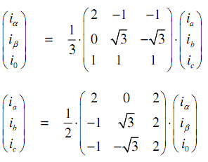
Representation of 3 phase as 2 phase system
Clark Transformation (α,β,0) – (a,b,c)

Slide 13
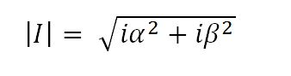
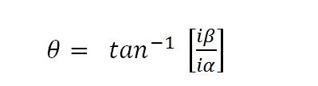
Representation of 2 phase system to a space Vector - | Mag | and Angle
Clark Transformation (α,β,0) – (a,b,c)

Slide 14



Reversing the Idea of Rotating Space vector of Machines – to apply in Converters for PWM technique
Three phase time varying Quantity applied to Space displaced Windings produce Equivalent single winding, rotating at supply frequency Excited by a DC voltage .

Slide 15


If you want the pearl don’t swim simply Dive

Slide 16
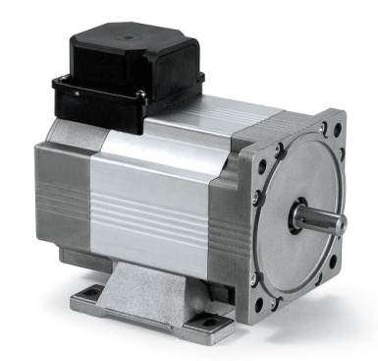
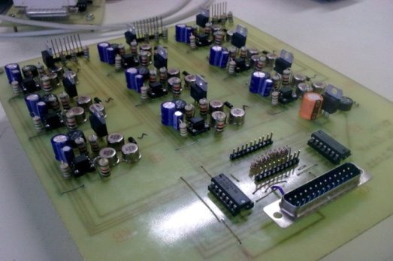
Space Vector From Machines To Power Electronics
Three phase time varying Quantity applied to Space displaced Windings produce an Equivalent single winding, rotating at supply frequency Excited by a DC voltage .
A DC voltage applied to an inverter can produce Three phase sinusoidal time varying outputs.
Where the inverter is made to behave like a three phase winding and Equivalent rotation of DC Voltage Excited winding is achieved through appropriate switching which imitates the Effect of Space Vector

Slide 17
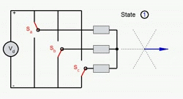
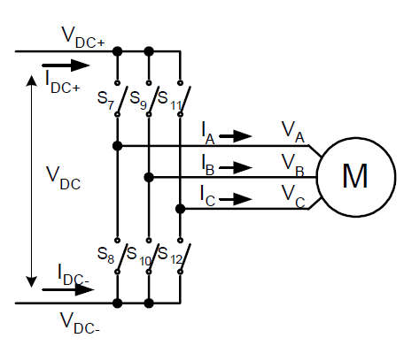
Graphical Representation of Switching Space Vectors in 3 Phase Inverter

Slide 18
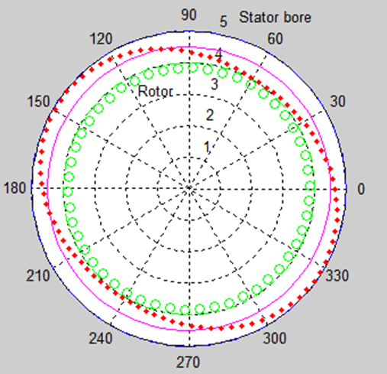
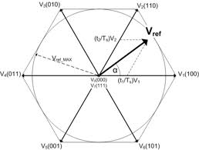
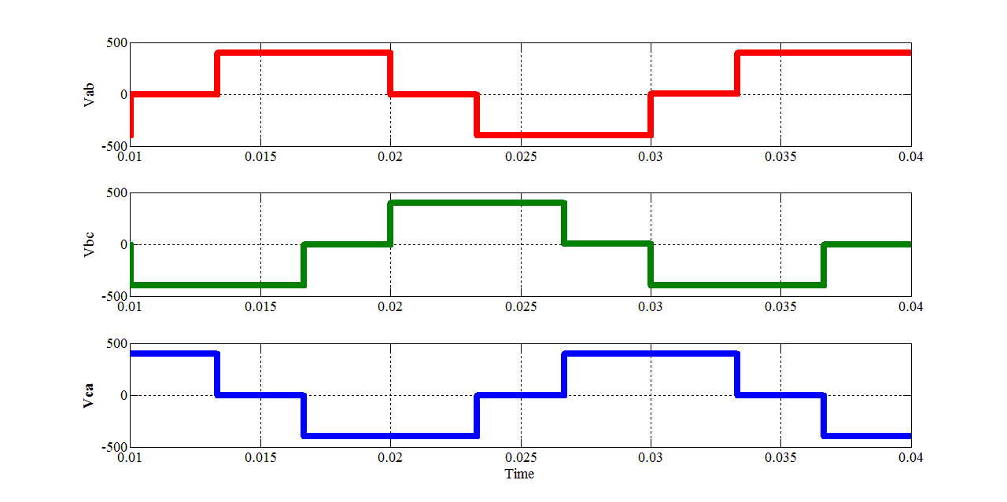
Space Vectors in Machines
Space Vectors in Power Electronics
SSNCE /EEE/ 13-03-2015/ S18

Slide 19
3 Phase Inverter Topology
SSNCE /EEE/ 13-03-2015/ S19

Slide 20
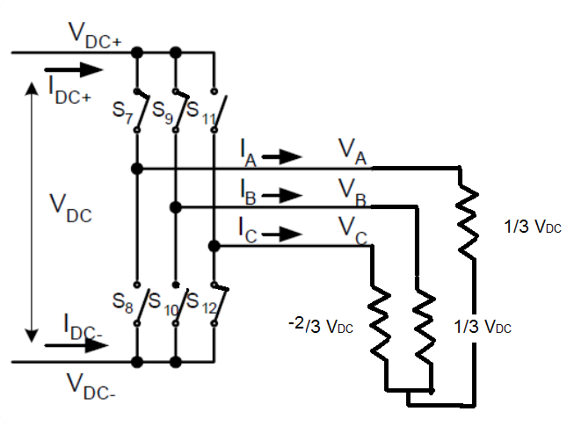
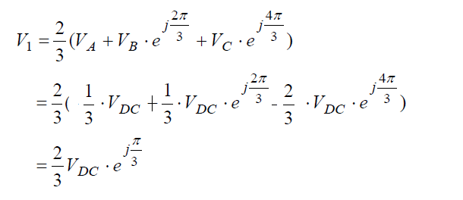
Equivalent Circuit for a Switching Pattern
Output Vector Position for Switching Pattern
Applying KVL
SSNCE /EEE/ 13-03-2015/ S20

Slide 21
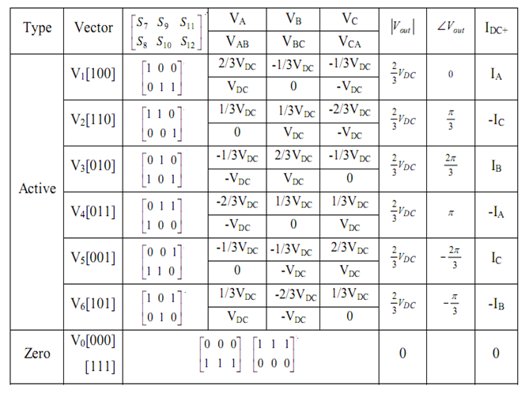
Switching Space Vectors in 3 Phase Inverter
SSNCE /EEE/ 13-03-2015/ S21

Slide 22
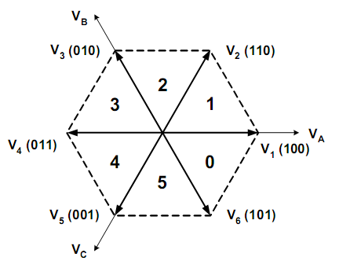
Graphical Representation of Switching Space Vectors in 3 Phase Inverter
SSNCE /EEE/ 13-03-2015/ S22

Slide 23
Graphical Representation of Switching Space Vectors in 3 Phase Inverter

Slide 24
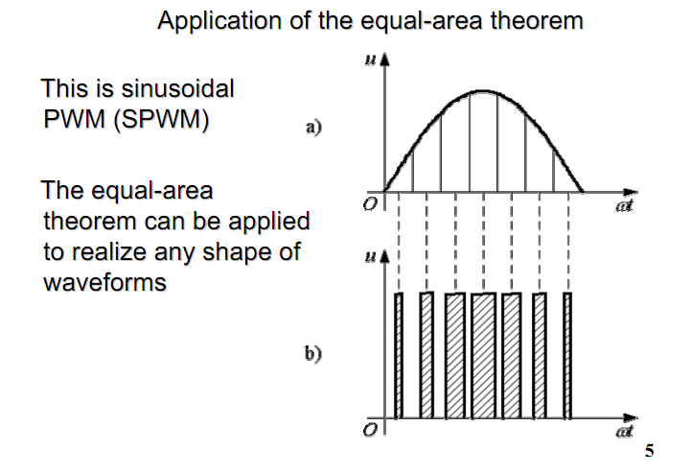
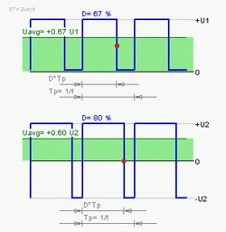
Principle of PWM
PWM - Methods… Equal Area Theorem

Slide 25
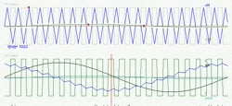
Sin PWM – Implementation of Equal Area Method

Slide 26
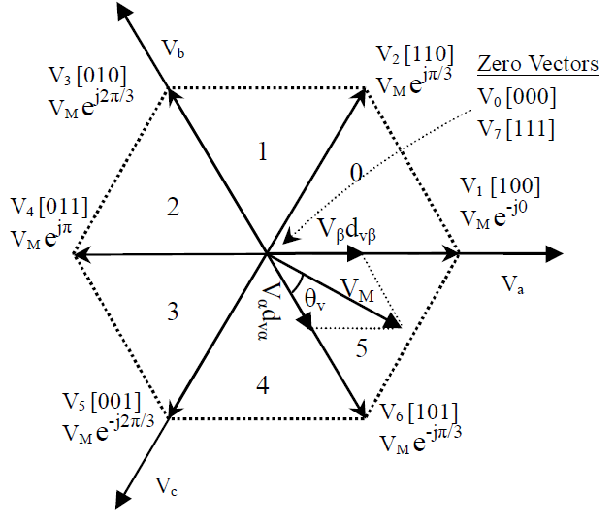
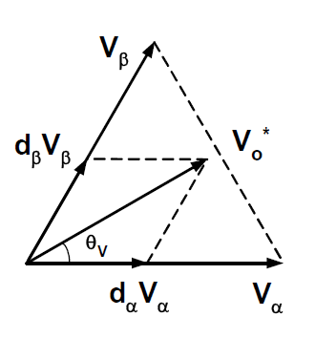
Application of Equal Area Theorem in Space Vector Modulation
Volt Second Balancing Scheme
SSNCE /EEE/ 13-03-2015/ S25

Slide 27
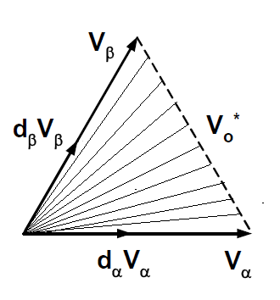
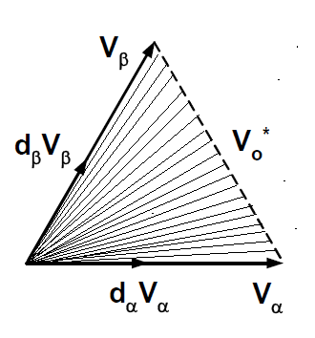
Effect of Sample Time (T_{s}) in SVM
T _{s} = 1e⁻³ Sec
T _{s} = 0.2e⁻³ Sec
SSNCE /EEE/ 13-03-2015/ S26

Slide 28
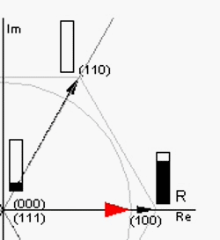
Space Vector – Implementation of Volt –second Balancing Method
-- V_{ref} Location versus Dwell Times

Slide 29
Space Vector – Implementation of Volt –second Balancing Method
Dwell Time Calculation
Volt-Second Balancing
T_{a}, T_{b} and T₀ – dwell times for and
T_{s} – sampling period
Space vectors
, and
(1)
SSNCE /EEE/ 13-03-2015/ S28

Slide 30
Space Vector – Implementation of Volt –second Balancing Method
- Dwell Times calculation
Solve (1)
(2)
SSNCE /EEE/ 13-03-2015/ S29

Slide 31
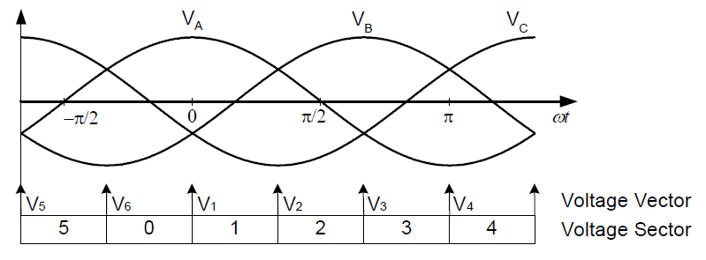
Space Vector - Sector Correspondence
SSNCE /EEE/ 13-03-2015/ S30

Slide 32
Space Vector Modulation
Seven-segment Switching Sequence
Selected vectors:
V₀, V₁ and V₂
Dwell times:
T_{s} = T₀ + T_{a} + T_{b}
Total number of switchings: 6

Slide 33
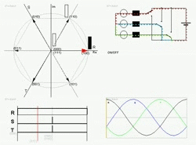
The Coordinated Dance of Vectors – Space Vector

Slide 34
Simulation – MATLAB
SSNCE /EEE/ 13-03-2015/ S33

Slide 35
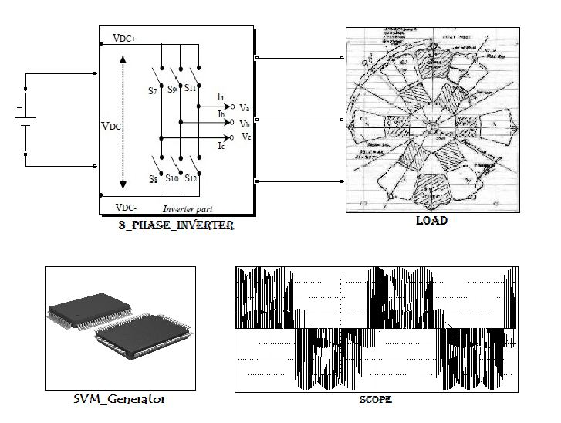
Don’t Stop With Hearing – Start Doing ……..
SSNCE /EEE/ 13-03-2015/ S34

Slide 36
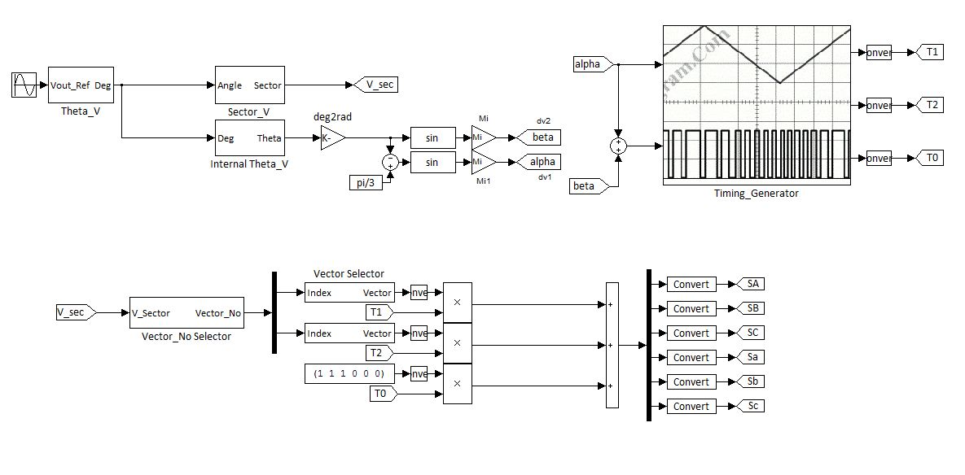
Don’t Stop With Hearing – Start Doing ……..
SSNCE /EEE/ 13-03-2015/ S35

Slide 37
Duty cycles of the Top switches
SSNCE /EEE/ 13-03-2015/ S36

Slide 38
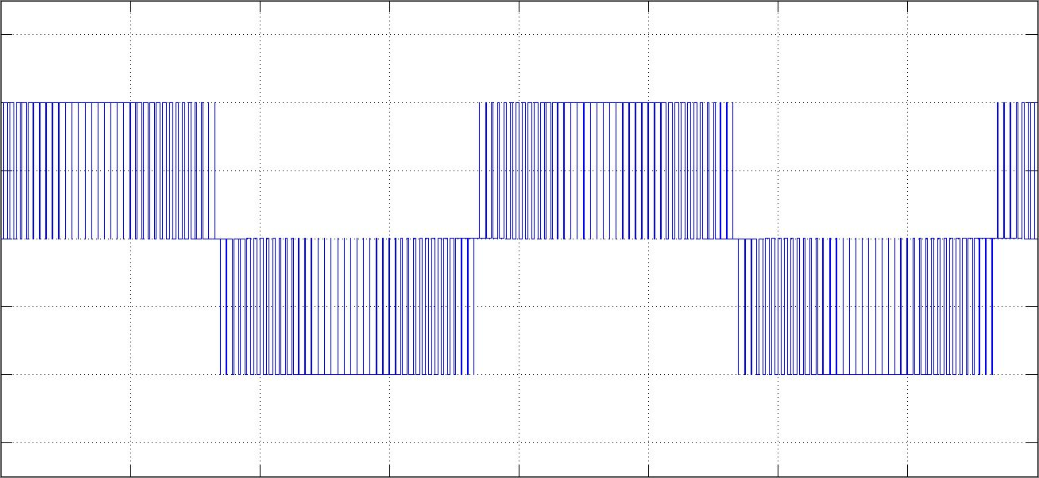
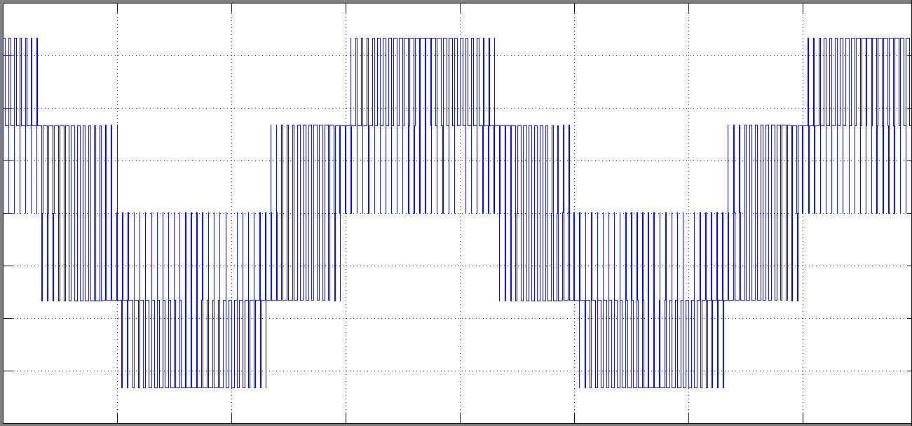
Output Line Voltage
Output Phase Voltage
SSNCE /EEE/ 13-03-2015/ S37

Slide 39
Output Current
Run – Matlab Simulation ( Theoretical – SVM)
SSNCE /EEE/ 13-03-2015/ S38

Slide 40
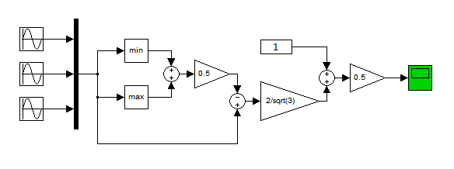
Practical Implementation
It can be observed that the duty cycles are simply the selected portions of the input reference waves at different times.
This inference can be formulated as a logic which leads to a simple implementation of SVM technique as shown below.
Run – Matlab Simulation ( Practical – SVM)
SSNCE /EEE/ 13-03-2015/ S39

Slide 41


SSNCE /EEE/ 13-03-2015/ S40

Slide 42


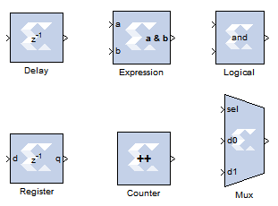
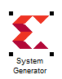
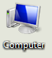
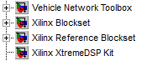
Embedded solution for SVM in Drives and Control
SSNCE /EEE/ 13-03-2015/ S41

Slide 43
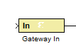
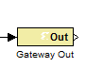
Model based design using MATLAB/System Generator Toolbox for Xilinx FPGAs
Control algorithm development in MATLAB -Xilinx tool box
Control Algorithm Developed with Xilinx tool box
Circuit inside the FPGA
FPGA
FPGA Pins
FPGA Pins
SSNCE /EEE/ 13-03-2015/ S42

Slide 44

Hardware - Setup
Driver – Concept 6SD 106EI (Scale Driver)
Power switches – BSM 25GP120
FPGA- Nexys -2 (Spartan 3E)
Encoder – 1000 PPR Quadrature Encoder)
SSNCE /EEE/ 13-03-2015/ S43

Slide 45



Matlab /Xilinx - implementation
Complete SVM _ Generator
SSNCE /EEE/ 13-03-2015/ S44

Slide 46



Matlab /Xilinx - implementation
Min_Max Envolope_ Generator
SSNCE /EEE/ 13-03-2015/ S45

Slide 47





Matlab /Xilinx - implementation
Pulse_ Generator
SSNCE /EEE/ 13-03-2015/ S46

Slide 48






SVM modulated V/F controlled Induction motor drive – Hardware Outputs
Duty cycles of the top switches
Starting an induction motor
Stopping an induction motor
Line Voltage of the Inverter
Switching pulses
Dead band
SSNCE /EEE/ 13-03-2015/ S47

Slide 49


Demonstration……… MATLAB - Xilinx Interface
SVPWM Based induction Motor Control
SSNCE /EEE/ 13-03-2015/ S48

Slide 50
Research at SSNCE
SSNCE /EEE/ 13-03-2015/ S49

Slide 51



Space Vector Modulation for MLI
SSNCE /EEE/ 13-03-2015/ S50

Slide 52










Mitigation of Effects of Unbalance using SVM
SSNCE /EEE/ 13-03-2015/ S51

Slide 53
Concluding Remarks on Space Vector Modulation
Greater DC Bus Utilization
Efficient Harmonic performance under high frequency switching
Mitigation of effects of unbalance in higher level inverters
Research Topic
SSNCE /EEE/ 13-03-2015/ S52

Slide 54

The End.....
May be a new Beginning
SSNCE /EEE/ 13-03-2015/ S53

Slide 55
Thanks to System Generator Toolbox MATLAB - Xilinx Interface
Thanks to the patience of the audience.
SSNCE /EEE/ 13-03-2015/ S54

Slide 56


Questions
SSNCE /EEE/ 13-03-2015/ S55

Slide 57

SSNCE /EEE/ 13-03-2015/ S56

Slide 58



Knowledge is Collection of Dead Facts and Information
Knowing is Melting of Mind into the Unknown
Knowledge is Someone Else's Knowing
Knowing is Your Knowledge
Zn Till [ ]
SSNCE /EEE/ 13-03-2015/ S57

Slide 59

“Follow your heart. Being a caterpillar you will become a butterfly”
- ZnTill [ ]
I said nothing it was all said earlier …..
Thank You …..
Leaving with the hope that next time I see any one of you , you say
“space vector is simple and I have implemented it myself”
“it is most difficult to find a simple way out” –
All simple things have a very complex theory behind it
- Albert Einstein
SSNCE /EEE/ 13-03-2015/ S58

Slide 60

Work not
for a Purpose
Work For
The Joy of Working
“ Take up a job you love not a day you will work”
- Thank You
Zn Till [ ]
SSNCE /EEE/ 13-03-2015/ S59

